Slide 1

MedLab Operations: Revenue, Retention, and Efficiency
This presentation will explore each challenge in depth, providing data-backed insights and actionable recommendations to transform these obstacles into opportunities for growth and improved patient care.

Slide 2
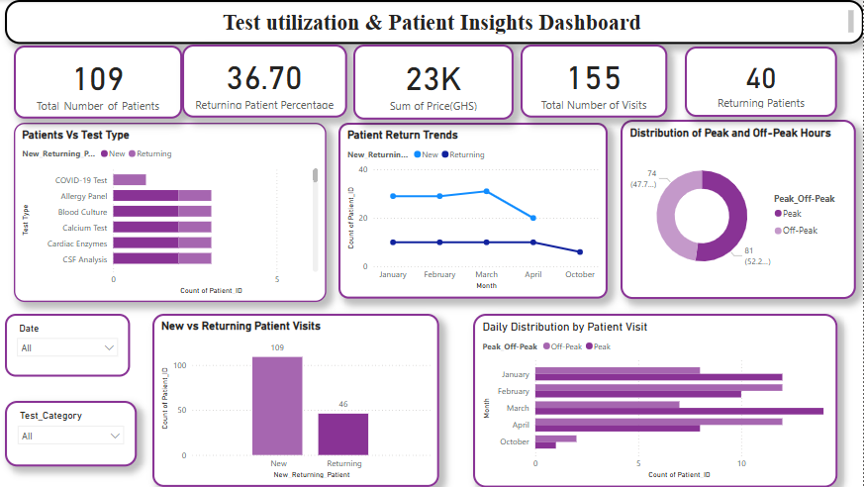

Slide 3




Revenue Inconsistency: The Utilization Gap
Popular Tests
Underutilized Tests
Revenue Risk
Pregnancy test, malaria test, liver function, full blood count, and cholesterol test show consistently high demand.
COVID-19 test, allergy panel, and calcium test remain significantly underutilized, creating revenue vulnerabilities.
Current revenue model is vulnerable to fluctuations if demand for top-performing tests unexpectedly decreases.

Slide 4
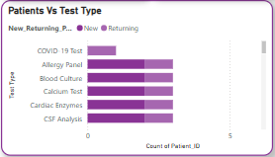
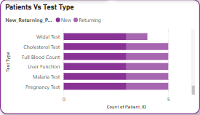
Underutilized and Popular Test Types

Slide 5

Strategies to Balance Test Utilization
Bundled Packages
First-Time Discounts
Awareness
.
Encourage first-time patients with 10–20% off less-used but essential tests..
Educate physicians and patients about the benefits of underutilized tests.
Promote low-demand tests via bundled packages

Slide 6
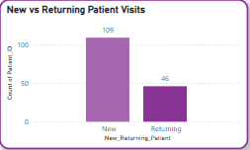
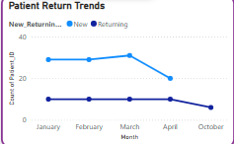
Low Patient Retention
Our analysis reveals a concerning retention rate of only 36.7%, meaning 63.3% of patients never return after their initial visit. The data shows 109 new patients compared to just 46 returning patients, with a downward trend in returning patients from March to October.
This low retention rate suggests potential issues with service satisfaction, lack of follow-up engagement, extended waiting times, or absence of loyalty incentives that would encourage repeat visits.

Slide 7

Retention Improvement Strategies
Post-Visit Follow-Ups
Implement automated follow-up communications to check on patients after their visit and remind them of future testing needs.
Loyalty Program
Develop a points-based loyalty system offering discounts on repeat tests and referral bonuses to incentivize return visits.
Patient Feedback System
Install suggestion boxes and conduct satisfaction surveys to identify pain points in the patient experience.
Personalized Care Plans
Create individualized testing schedules for patients with ongoing health
monitoring needs.

Slide 8
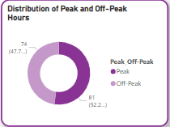
Inefficient Lab Operations: The Peak Hour Problem
Peak Hours
Off-Peak Hours
52.2% of patients (81)
47.7% of patients (74)
Longer wait times
Underutilized capacity
Increased staff stress
Inefficient resource allocation
Potential quality concerns
Missed revenue opportunities
Our analysis confirms an operational imbalance, with peak hours handling 52.2% of patient volume while off-peak hours remain underutilized at 47.7%. This imbalance creates bottlenecks during busy periods and wasted capacity during slower times, affecting both patient satisfaction and operational efficiency.

Slide 9
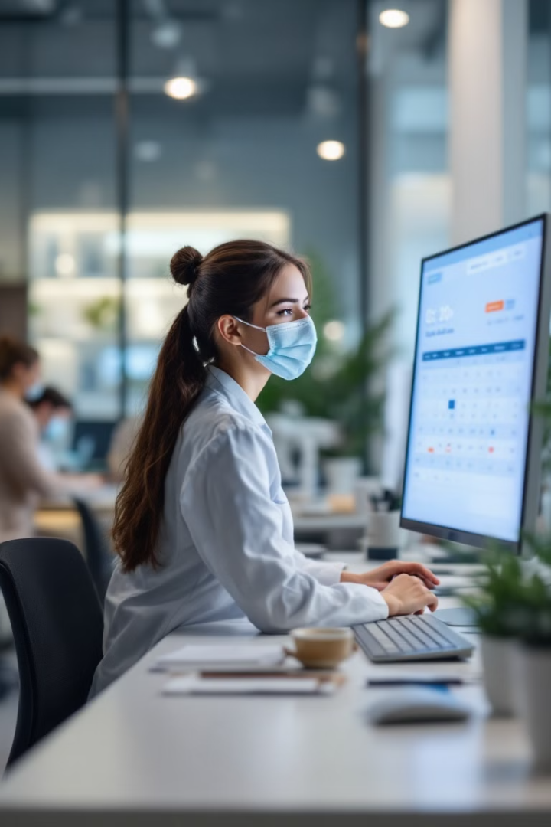



Balancing Patient Flow: Optimizing Schedule
Differential Pricing
Offering reduced prices or faster service during off-peak periods
Online Booking System
Encouraging online bookings by implementing a digital scheduling platform to allow users to choose off-peak slots
Dynamic Staffing Model
Reassign staff shifts to balance workload (Allocate more staff during peak times and fewer during off-peak hours to match patient flow)
.

Slide 10
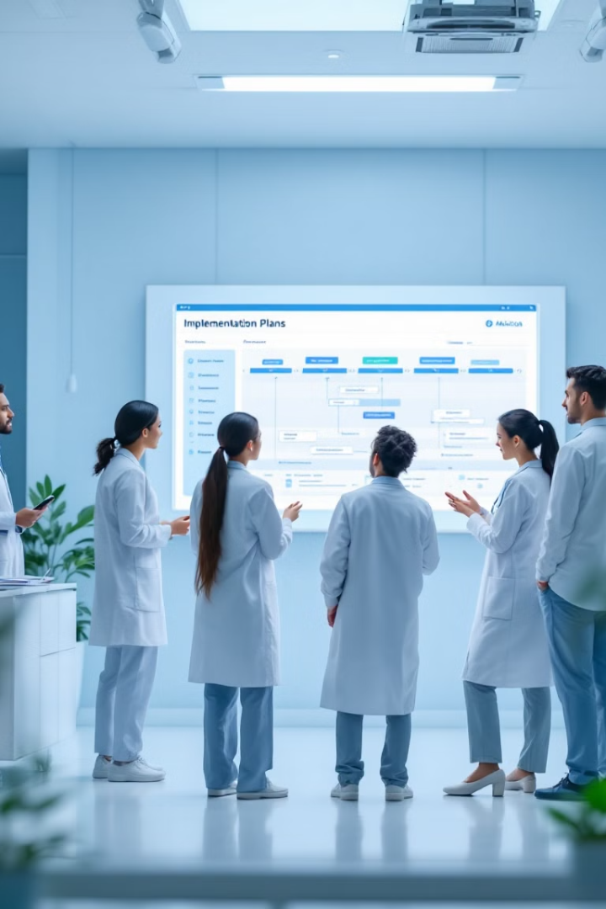
Key Takeaways & Implementation
1
Launch patient satisfaction surveys and implement basic follow-up communications to address retention issues.
2
Develop and introduce bundled test packages and differential pricing for
peak/off-peak hours.
3
Deploy online booking system and begin physician education campaign
about underutilized tests.
4
Implement loyalty program and optimize staffing model based on refined
patient flow data.
By addressing these three interconnected challenges, we can create a more balanced revenue stream, improve patient retention, and optimize operational efficiency. The recommended strategies work together to create a more sustainable laboratory business model that better serves both patients and staff.

Slide 11

THANK YOU
TEAM:
MARY DUODU
STEPHANIE AYIVOR
MENA MENSIWAA KUMI

